Slide 1



Ad-hoc Insights – Consumer Goods Domain
Task Details
Provide insights to management in consumer goods domain
Role: Junior Data Analyst
Tools: SQL + Power BI — Data Analysis & Visualisation
Resume Project Challenge - 7

Slide 2



Challenge Overview
AtliQ Hardwares
Critical Gap
Major computer hardware manufacturer expanding globally across markets
Management lacks actionable insights for fast, data-driven decision-making

Slide 3

Problem Statement
AtliQ Hardwares is experiencing rapid global expansion but struggles to extract actionable business intelligence from existing data systems.
Management Requirements
Enhanced visibility into sales performance and product metrics
Real-time financial indicators for strategic planning
Data-backed decision-making capabilities
Analysts with strong SQL expertise and business communication skills

Slide 4
Task Requirements
01
02
Review Business Requests
Write SQL Queries
Analyse 10 ad-hoc requests from management team
Develop optimised queries to extract relevant data insights
03
04
Create Power BI Visuals
Present to Management
Transform SQL results into compelling, actionable visualisations
Deliver findings with audio/video presentation (extra weightage)
Provided Resources
DatasetComplete sales & finance data
MetadataTable schemas & definitions

Slide 5
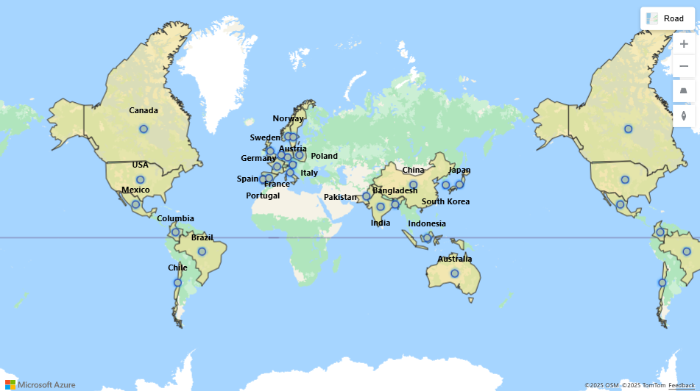
Business Overview
Global Presence
Operating across multiple continents with expanding market reach in consumer goods sector
Product Portfolio
Comprehensive range of computer hardware, peripherals, and technology solutions
Rapid Growth
Accelerated expansion requiring sophisticated data analytics capabilities

Slide 6

Goals & Objectives
Strategic Goals
Sales Performance
Track revenue trends, regional performance, and customer behaviour patterns
Financial Health
Monitor profitability, cost structures, and fiscal year comparisons
Product Analytics
Identify top performers, underperforming items, and category insights
Deliverable Outcomes
Actionable insights for executive decision-making
Clear visualisations for stakeholder communication
Data-driven recommendations for growth strategies
Comprehensive analysis spanning FY2019–FY2021

Slide 7

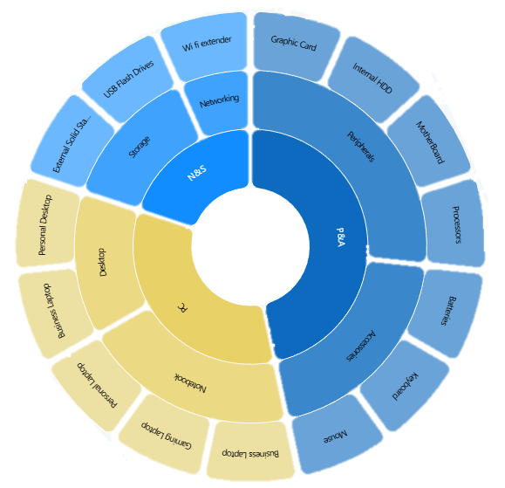



Business Product Hierarchy
Division
1
Top-level categorisation
2
Segment
Market segments within divisions
3
Category
Product categories per segment
4
Product
Individual SKUs and variants
Divisions
Key Segments
Personal Computing
Notebook
Networking & Storage
Desktop
Peripherals & Accessories
Accessories

Slide 8
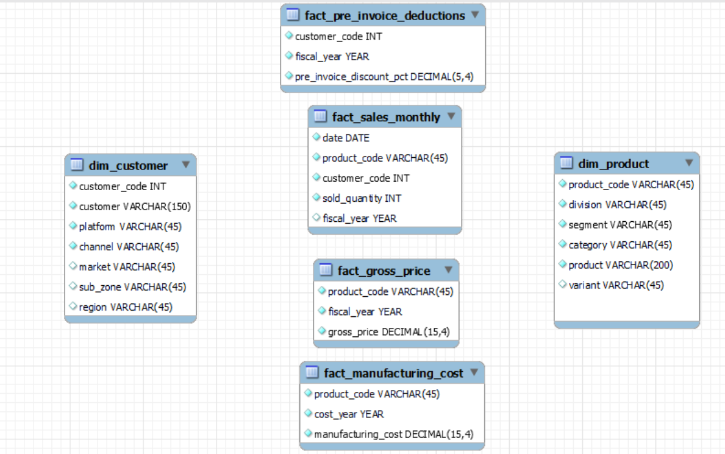


Database Structure Overview
The AtliQ Hardwares database comprises multiple interconnected tables capturing sales transactions, customer information, product details, and financial metrics across fiscal years.
Fact Tables
Sales Monthly
Gross Price
Manufacturing costs
Pre Invoice Deductions
Dimension Tables
Customers
Products

Slide 9




Next Steps
Ready to Analyse
With a comprehensive understanding of the challenge requirements, business context, and database structure, we're prepared to execute the analysis and deliver actionable insights.
Query Development
Visual Creation
Final Presentation
Write optimised SQL
Build Power BI dashboards
Deliver to management

Slide 10
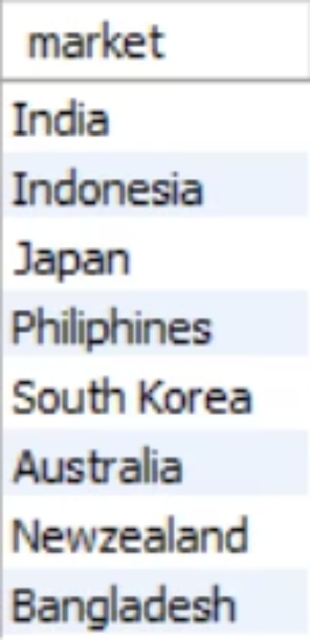
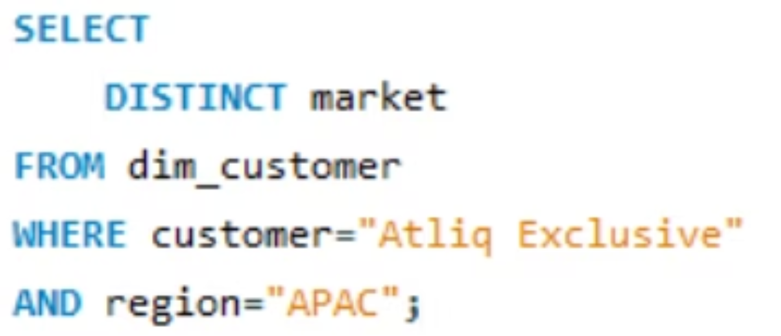
1. Markets for "AtliQ Exclusive" in the APAC Region
The first ad-hoc request involves identifying all operational markets for our key customer, "AtliQ Exclusive", specifically within the Asia-Pacific (APAC) region. This insight is crucial for strategic resource allocation and targeted business development efforts.

Slide 11
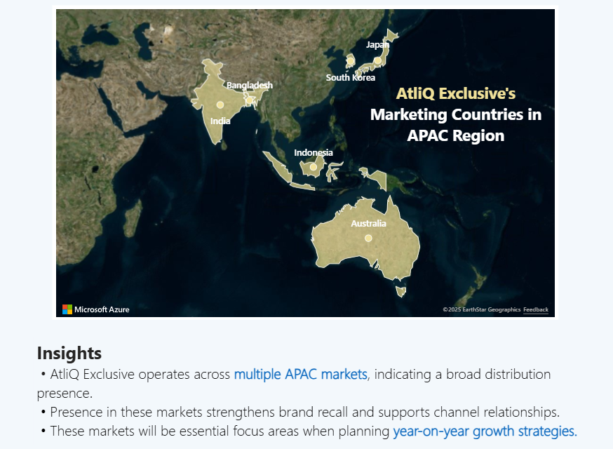
AtliQ Exclusive Business Operations in the APAC region
Insights
• AtliQ Exclusive operates across multiple APAC markets, indicating a broad distribution presence.
• Presence in these markets strengthens brand recall and supports channel relationships.
• These markets will be essential focus areas when planning year-on-year growth strategies.

Slide 12
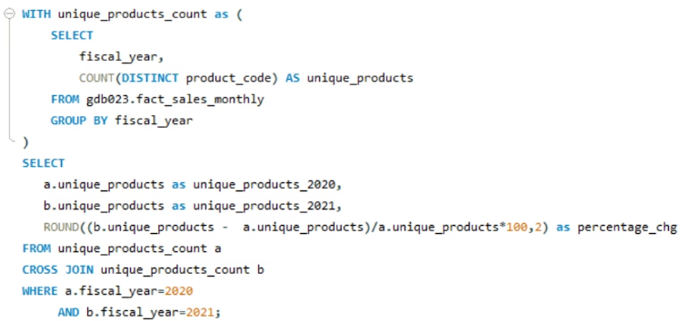
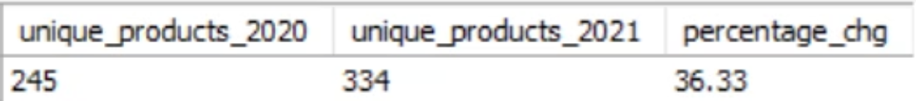
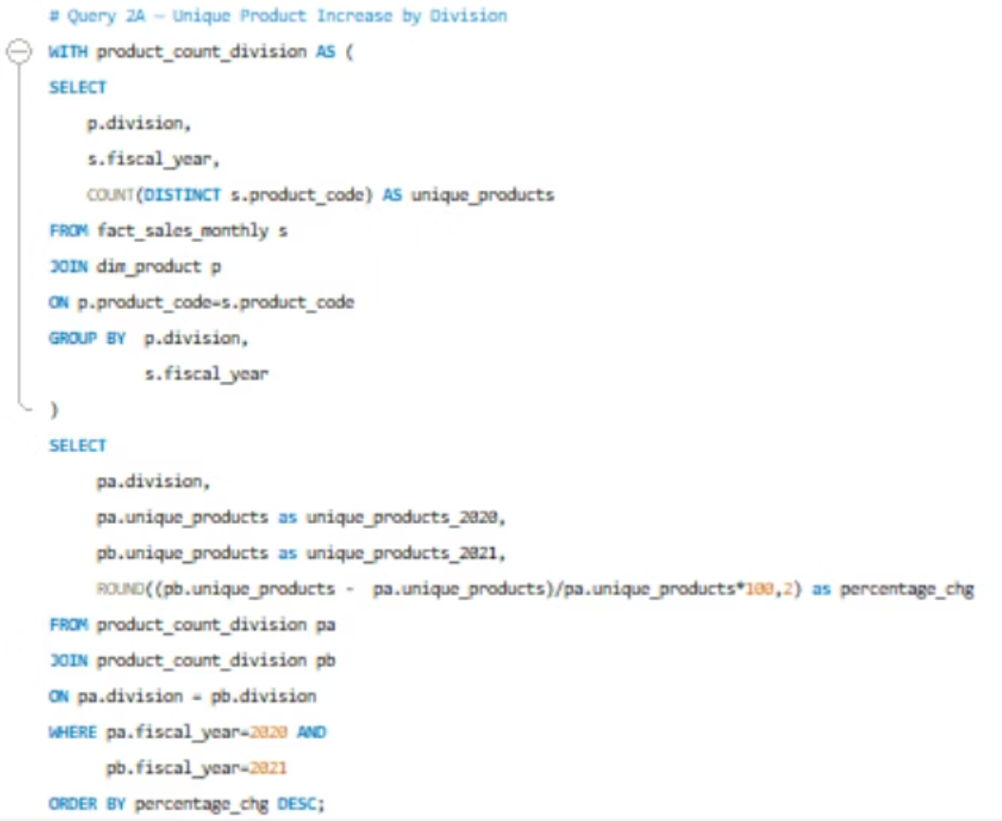
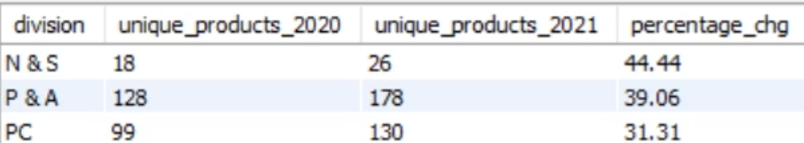
2. Unique Product Growth Analysis: 2021 vs 2020
This analysis examines the percentage increase in unique products between 2020 and 2021, providing crucial insights into our product portfolio expansion and overall business growth. Understanding this metric helps us assess the effectiveness of our product development strategies and market responsiveness.

Slide 13
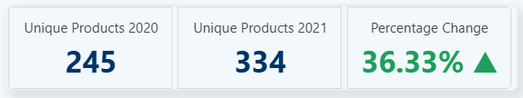
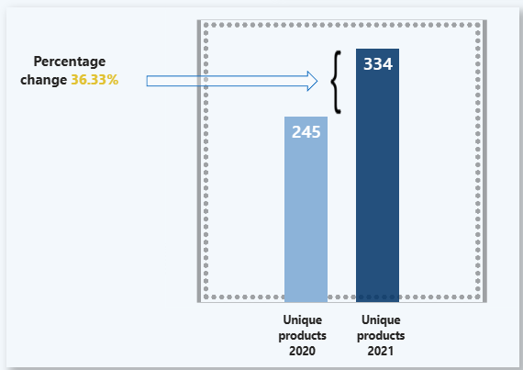
Percentage of Unique Product in 2021 vs. 2020
Insights
The unique product portfolio expanded from 245 to 334 SKUs between FY 2020 and FY 2021.
This reflects a 36.33% YoY increase in product diversification — a strong expansion signal.
The increase suggests that AtliQ invested in broadening its product lineup, potentially to:
Capture more customer segments
Respond to specific market or customer demands
Compete more effectively in fast-growing product categories
The growth in SKUs likely contributed to:
Improved market coverage
Greater channel partner engagement
Enhanced brand presence & portfolio strength

Slide 14
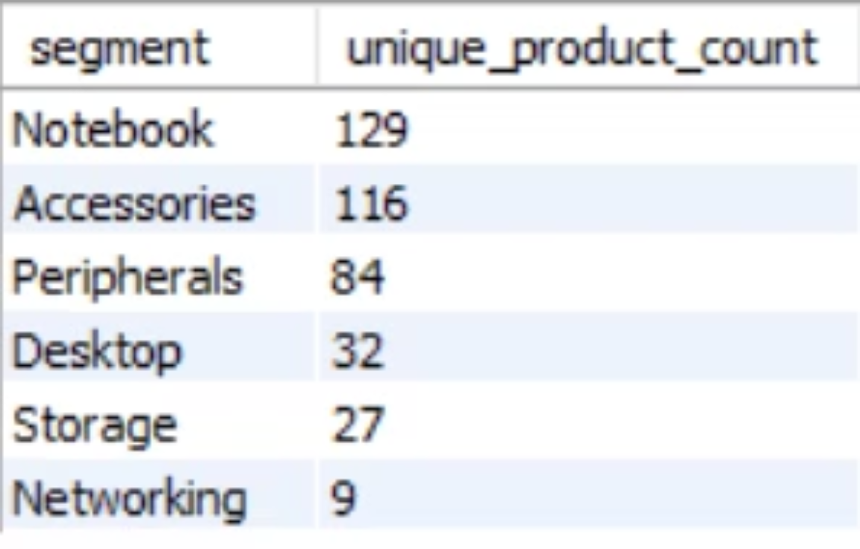
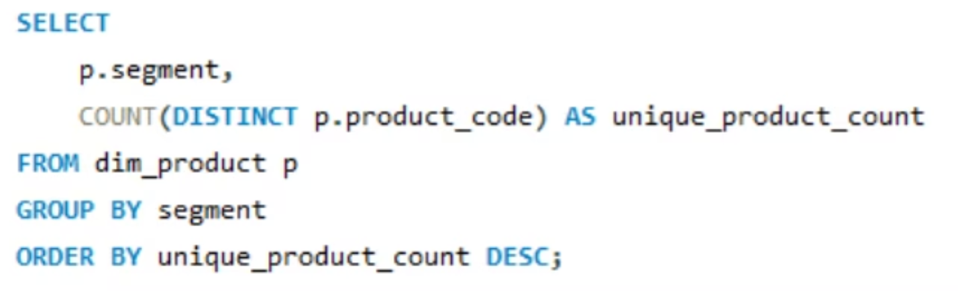
3. Product Count Analysis by Segment
This analysis provides a comprehensive report of unique product counts for each business segment, sorted in descending order to identify which segments have the largest product portfolios. This helps us understand resource allocation and market focus areas.

Slide 15
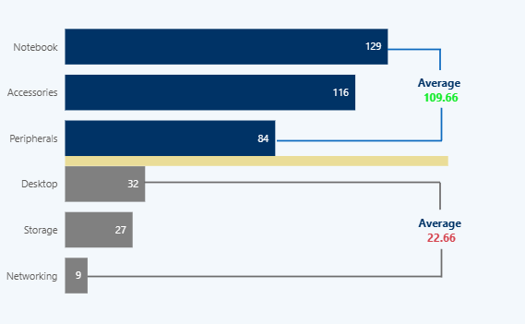
Unique Product Counts for Each Segment
Insights
Notebook, Accessories, and Peripherals have high sales volume and are the main revenue drivers.
Their average sales (~110) indicate strong and consistent customer demand.
Desktop, Storage, and Networking have very low sales, averaging around 23, indicating declining or niche demand.
The product portfolio is skewed toward portable and add-on products rather than traditional desktops.

Slide 16
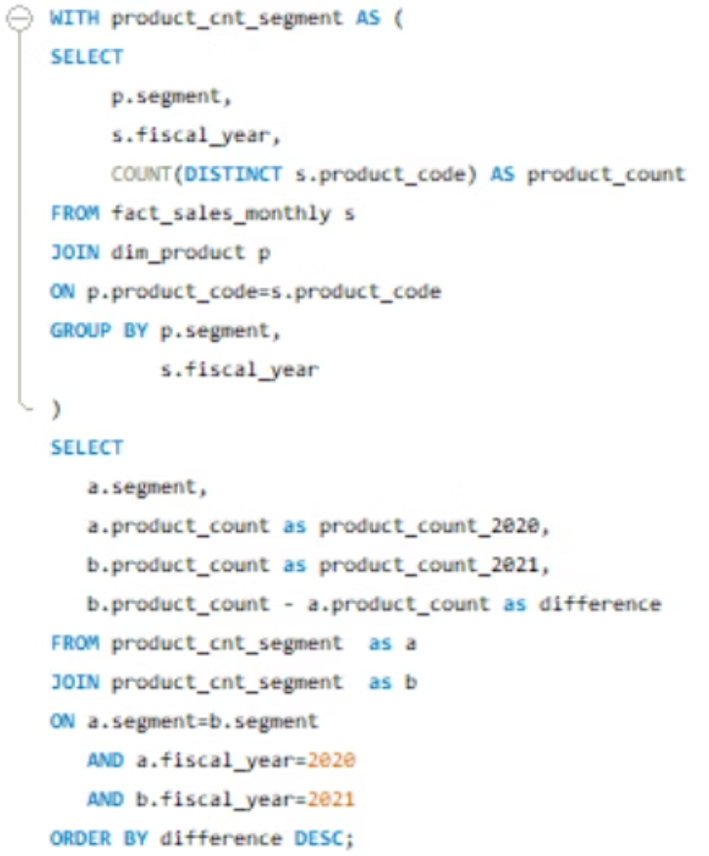
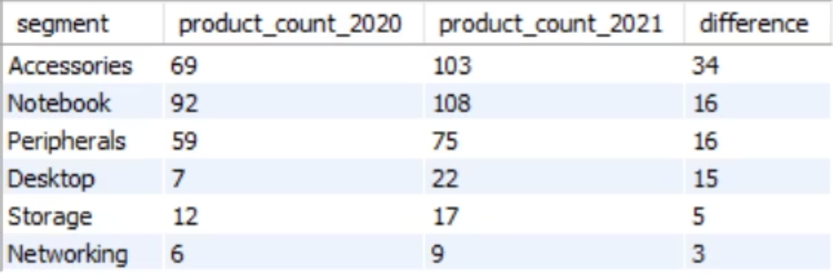
4. Segment Product Growth Analysis: 2021 vs 2020
This follow-up analysis identifies which business segment experienced the most significant increase in unique products between 2020 and 2021. By comparing product counts across segments over time, we can pinpoint areas of strategic expansion and investment focus.

Slide 17
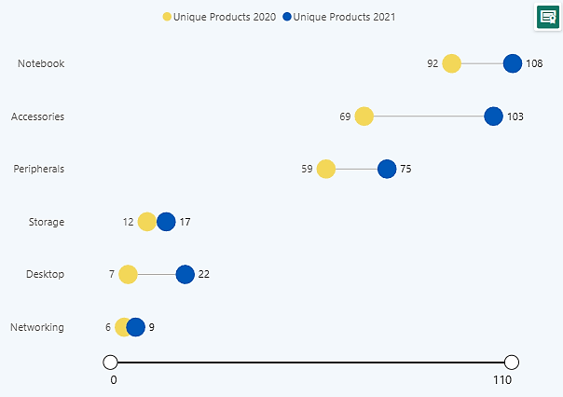
Most Increase in Unique Products Segment-wise in 2021 vs 2020
Insights
Accessories showed the strongest growth (+34), indicating a major product expansion focus in this segment.
Notebook and Peripherals saw steady growth (+16 each), supporting core portfolio stability.
Desktop, though small, recorded a notable relative increase (+15), suggesting targeted market push.
Storage had minimal change (+5), implying either a mature or lower-priority segment.
Overall trend shows wider product diversification, led primarily by Accessories and supported by core segments.

Slide 18
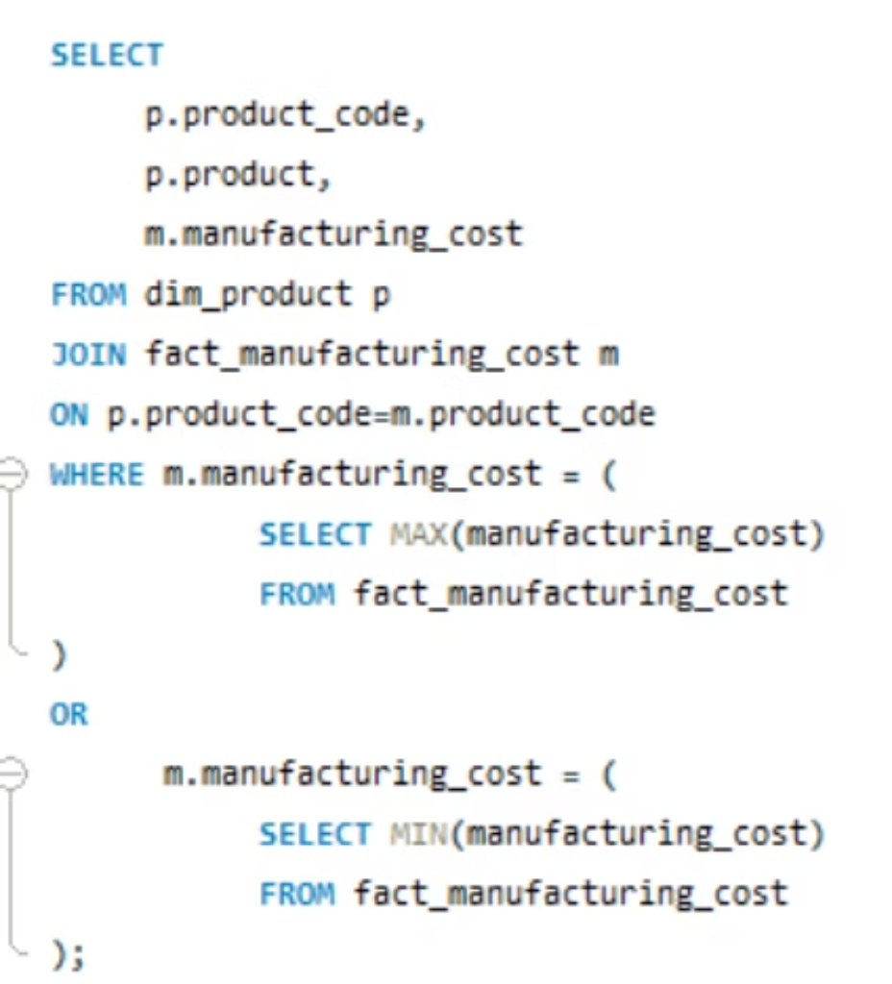
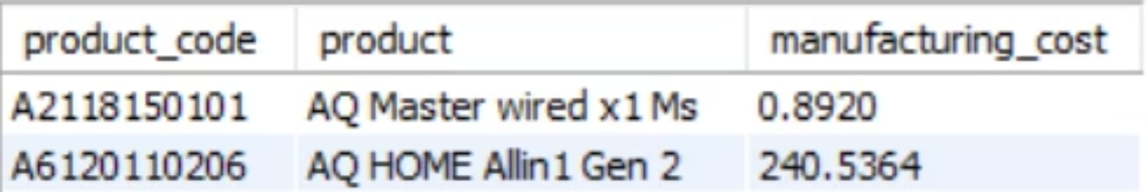
5. Products by Manufacturing Cost (Highest & Lowest)
This analysis identifies products with the most significant manufacturing costs (both highest and lowest) to highlight key cost drivers and potential areas for optimization or strategic pricing. Understanding these extremes is vital for cost management and profitability analysis.

Slide 19
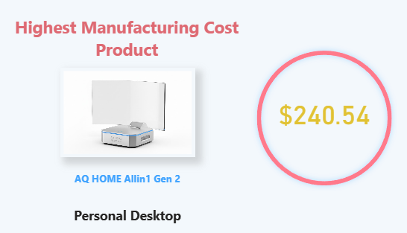
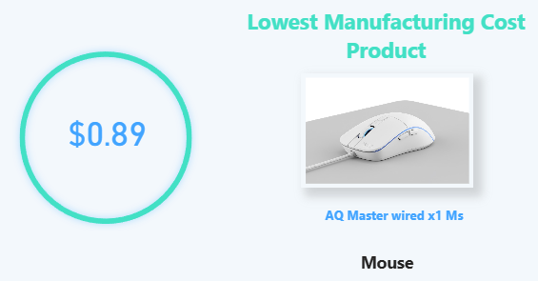
Highest and Lowest Manufacturing Cost Products

Slide 20
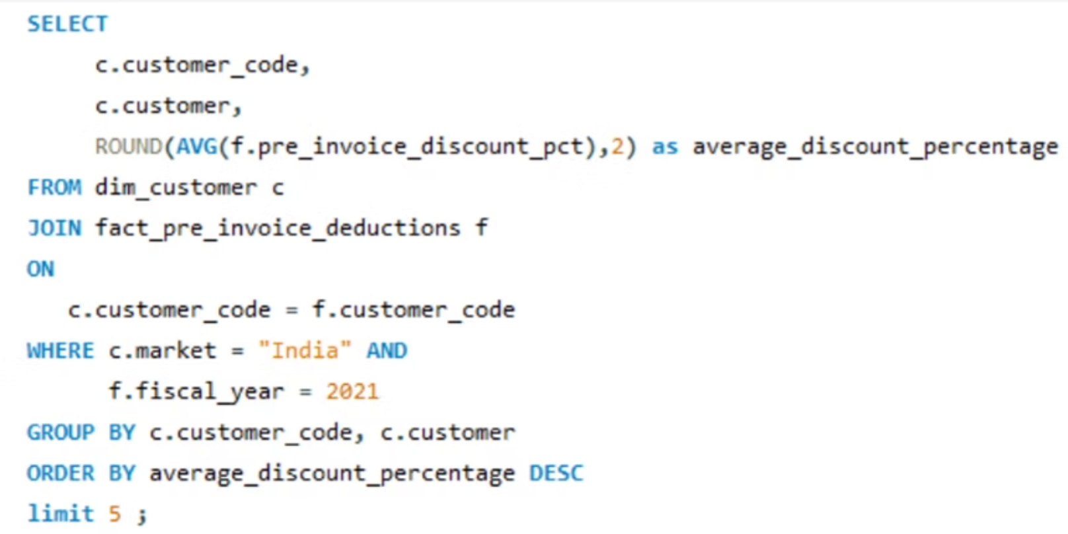
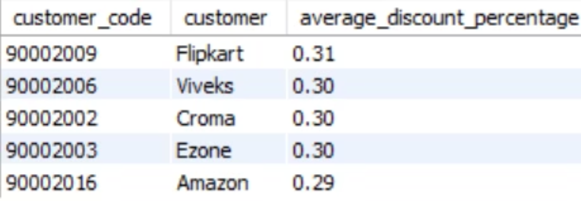
6. Top 5 Customers by Average Pre-Invoice Discount (FY21, India)
This report identifies the top 5 customers who received the highest average pre-invoice discount percentage during the fiscal year 2021 within the Indian market. Understanding these key relationships is crucial for optimizing discount strategies and customer profitability.

Slide 21
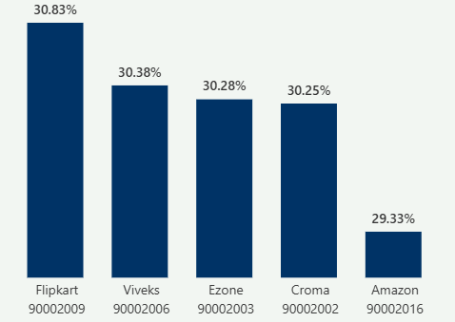
Top 5 Customers by Average Pre-Invoice Discount (FY21, India)
Insight
Large retail partners like Flipkart and Croma received the highest pre-invoice discounts in FY21, indicating volume-driven pricing.
Flipkart received the highest average pre-invoice discount (30.83%) among Indian market customers in FY 2021.
Viveks, Croma, and Ezone follow closely at 30.38%,30.28% & 30.25%, indicating competitive pricing strategy for major retail partners.
Amazon also appears in the top 5 but with a slightly lower discount at 29.33%, suggesting tighter margin negotiations.

Slide 22
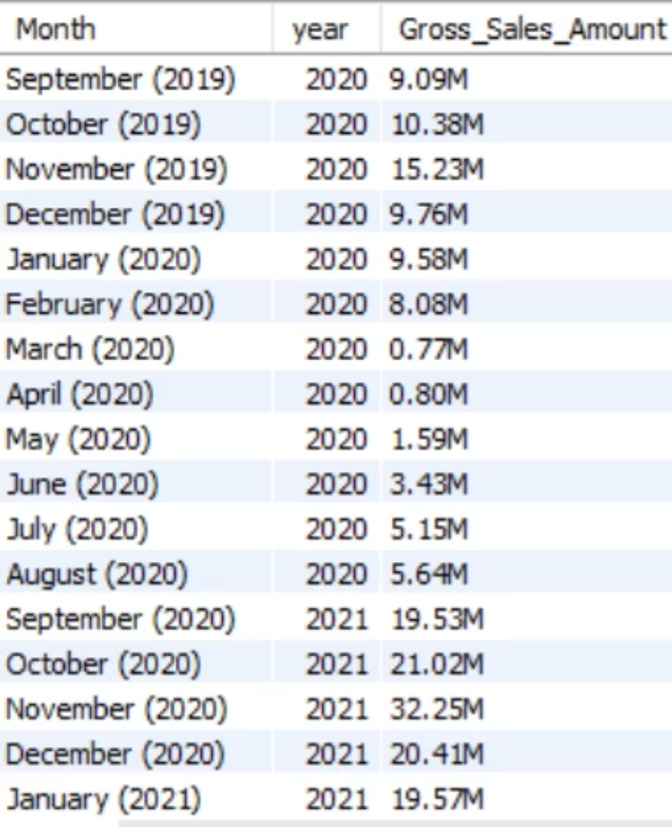
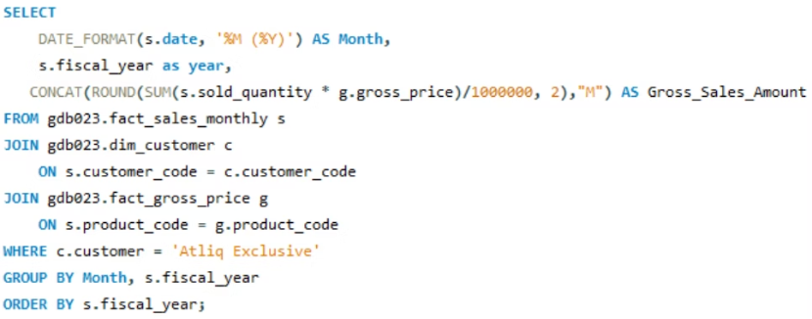
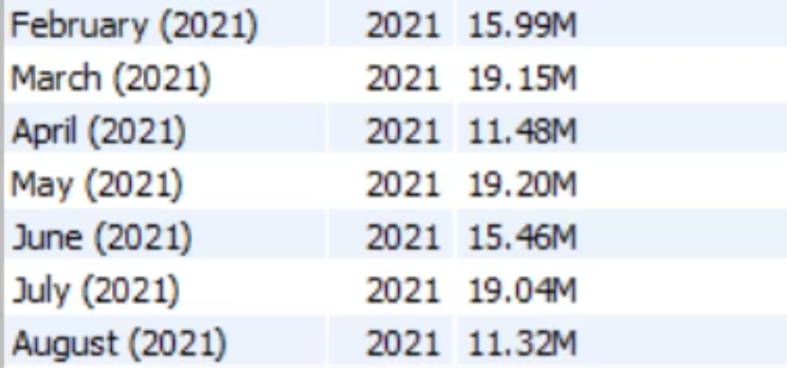
7. Monthly Gross Sales Report: AtliQ Exclusive
This comprehensive analysis provides a complete monthly breakdown of gross sales amounts for our key customer "AtliQ Exclusive". By tracking performance across months and years, we can identify seasonal patterns, high and low-performing periods, and make strategic decisions about resource allocation and sales planning.

Slide 23
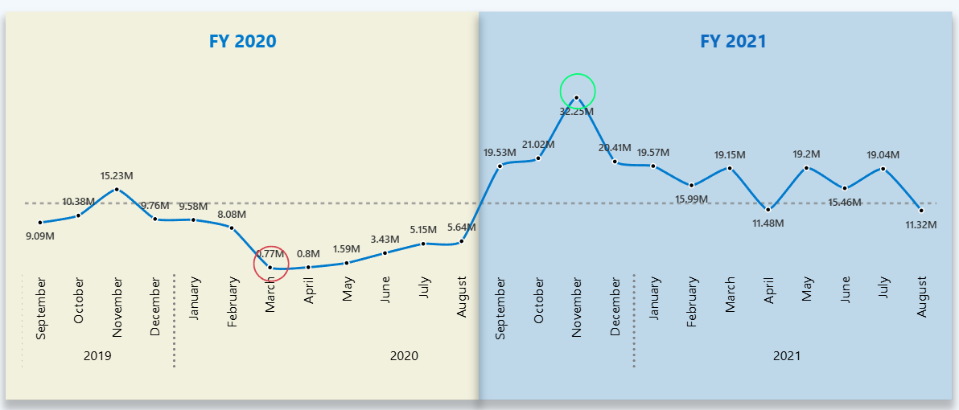
Monthly Gross Sales Report: AtliQ Exclusive

Slide 24
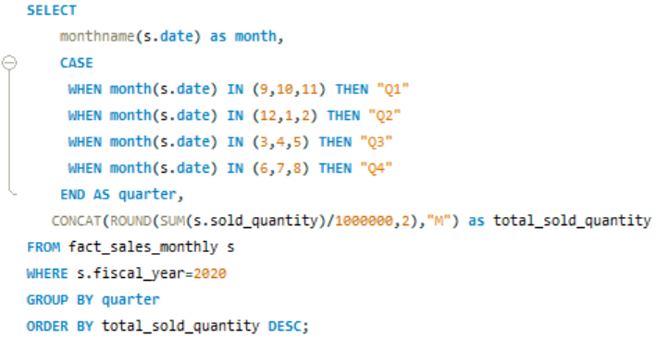
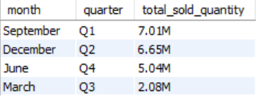
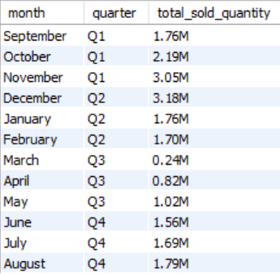
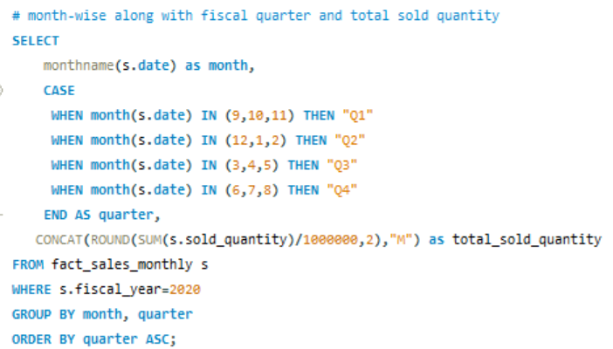
8. Quarter with Maximum Total Sold Quantity (FY2020)

Slide 25
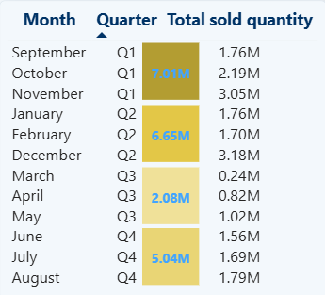
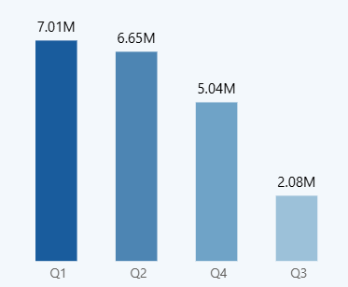
Quarter with Maximum Total Sold Quantity (FY2020)
📌 Key Insights — Quarterly Sold Quantity (FY 2020)
Q1 is the top-performing quarter with 7.01M units — driven mainly by November and October.
Q2 remains strong at 6.65M, showing stable performance despite seasonal fluctuations.
Q4 holds third place with 5.04M, boosted slightly by June.
Q3 is the weakest quarter at 2.08M, reflecting low sales especially in March and April.
Overall, the business experiences a clear early-year peak (Q1–Q2) and a significant dip in mid-year (Q3).

Slide 26
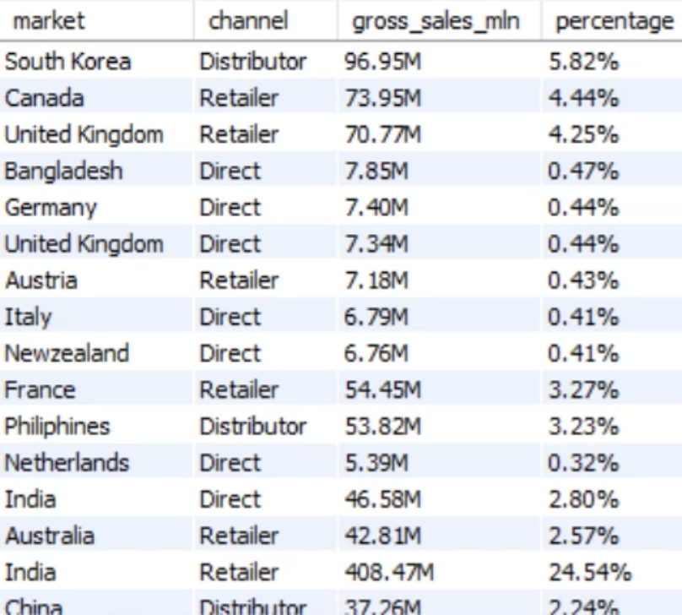
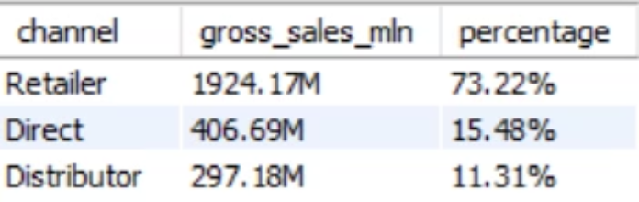
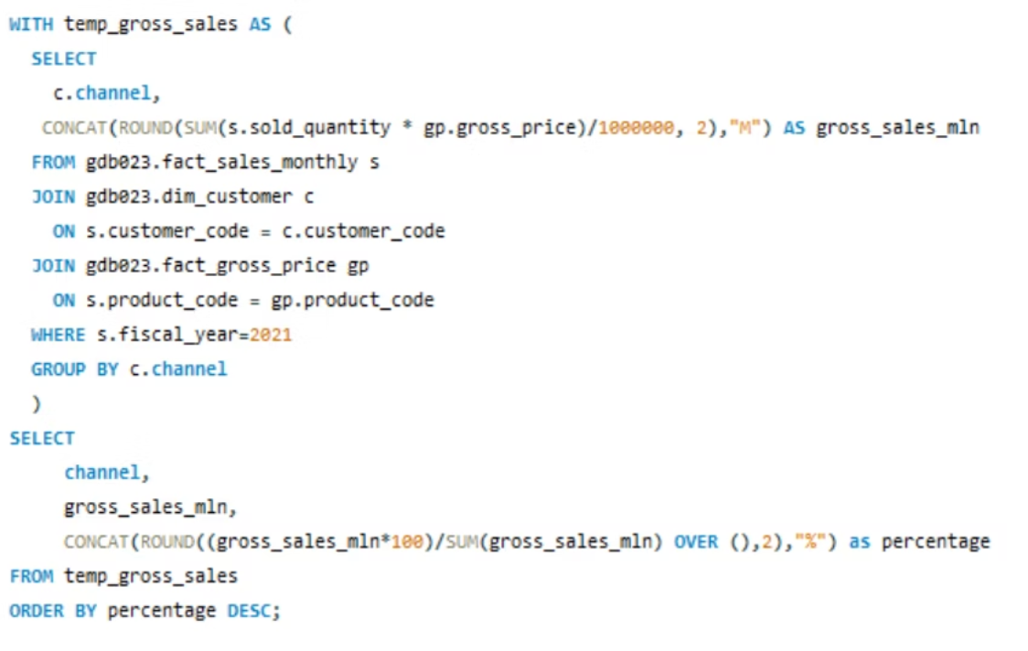
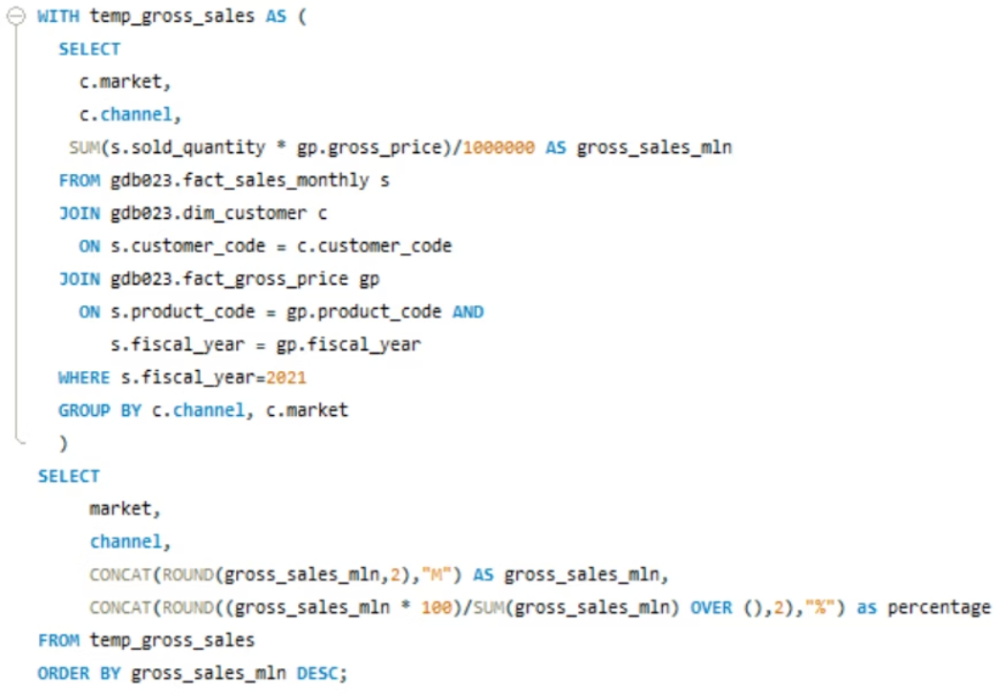
9. Channel Gross Sales Contribution (FY21)
This analysis identifies the sales channels that contributed the most to gross sales in Fiscal Year 2021, along with their respective percentage contributions. This insight is crucial for optimizing channel strategies and resource allocation for maximum revenue growth.

Slide 27
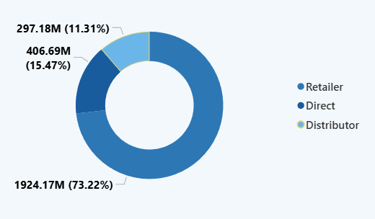
9. Channel Gross Sales Contribution (FY21)
INSIGHTS — Channel Contribution (FY 2021)
1. Retail dominates majority of revenue
Retail contributes ~73% of total FY21 gross sales.
This is the organization’s largest and strongest revenue driver.
2. Direct channel is the second major contributor
Direct contributes ~15%.
It shows steady performance but not near Retail.
3. Distributor channel contributes the least
Distributor contributes ~11%.
This indicates opportunity for expansion but also highlights lower reach or lower order volumes.

Slide 28


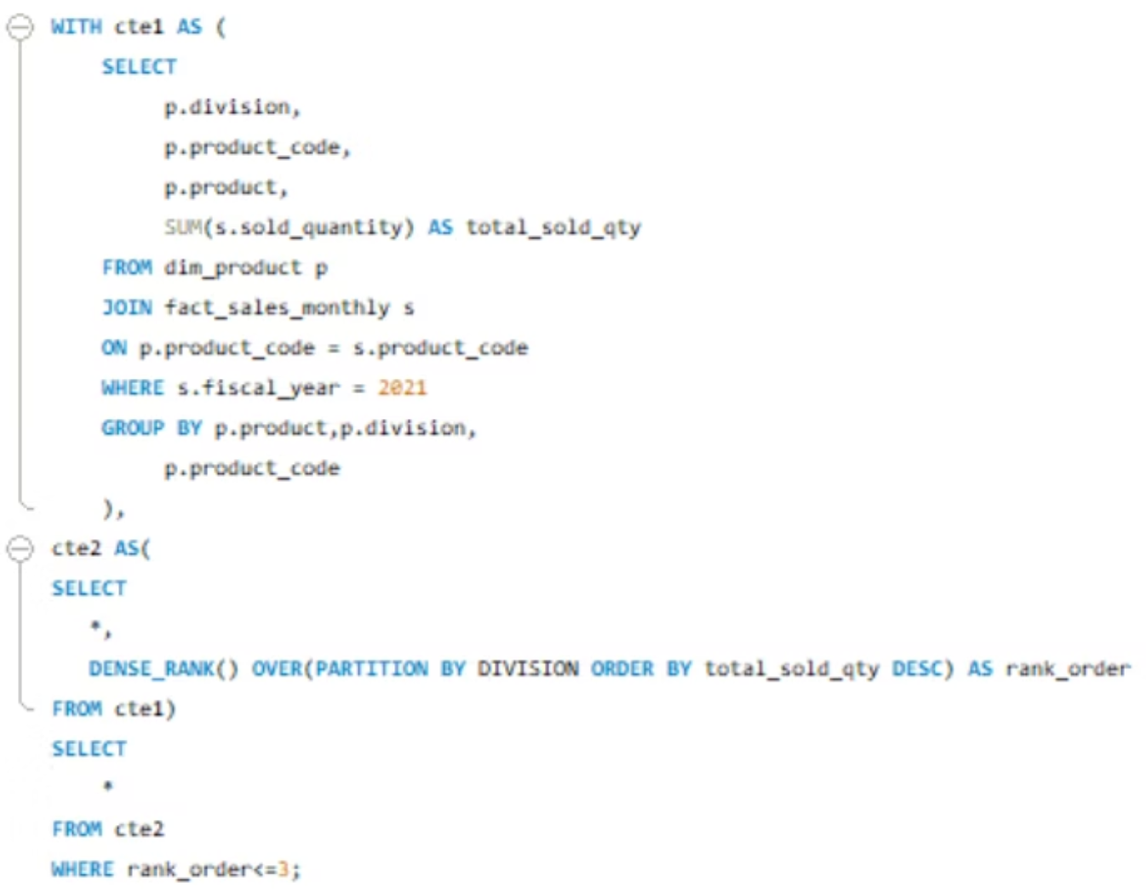
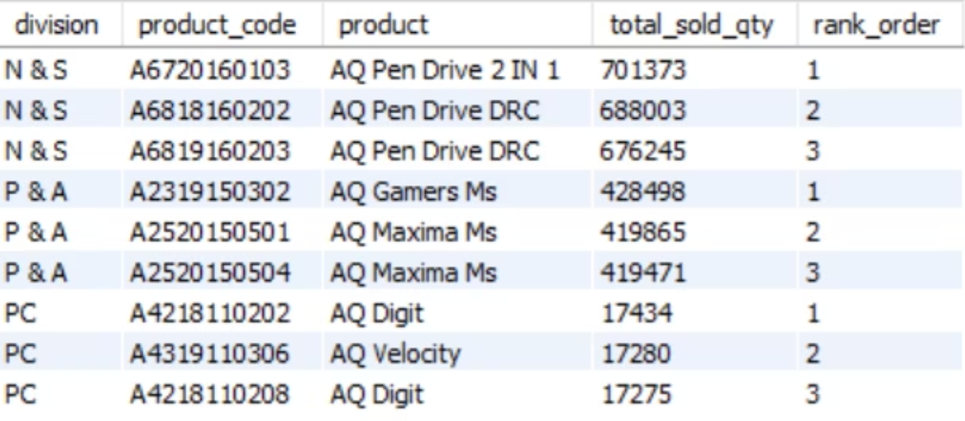
10. Top 3 Products by Division (FY21 Total Sold Quantity)
This analysis identifies the top 3 products in each division based on their total sold quantity during Fiscal Year 2021. Understanding which products are top performers within specific divisions helps in strategic planning, inventory management, and marketing efforts tailored to maximize success for high-demand items.

Slide 29
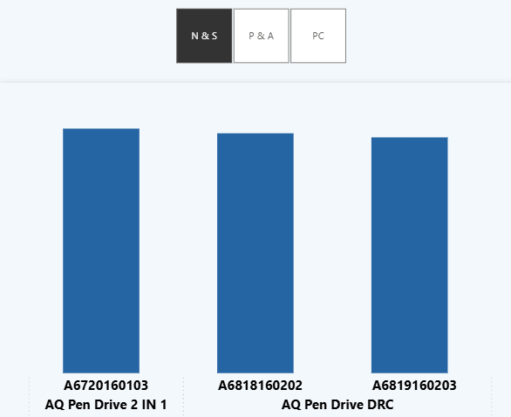
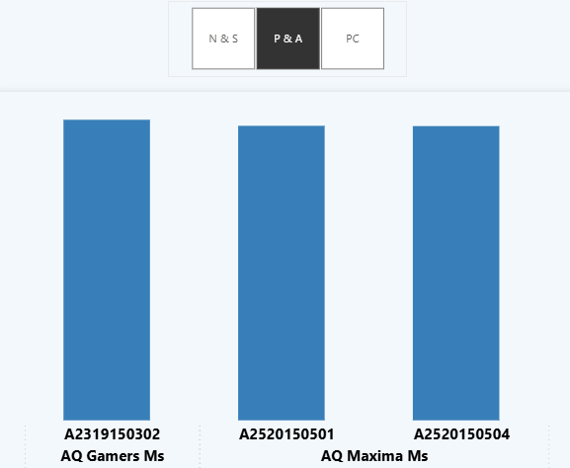
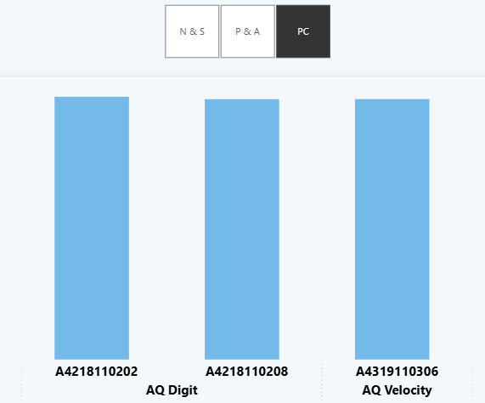
Top 3 Products by Division (FY21 Total Sold Quantity)

Slide 30
Thank You
We appreciate your time and attention to these insights. We are committed to leveraging data for strategic growth and look forward to our continued success.
Presented by Arindam Das.

